Slide 1
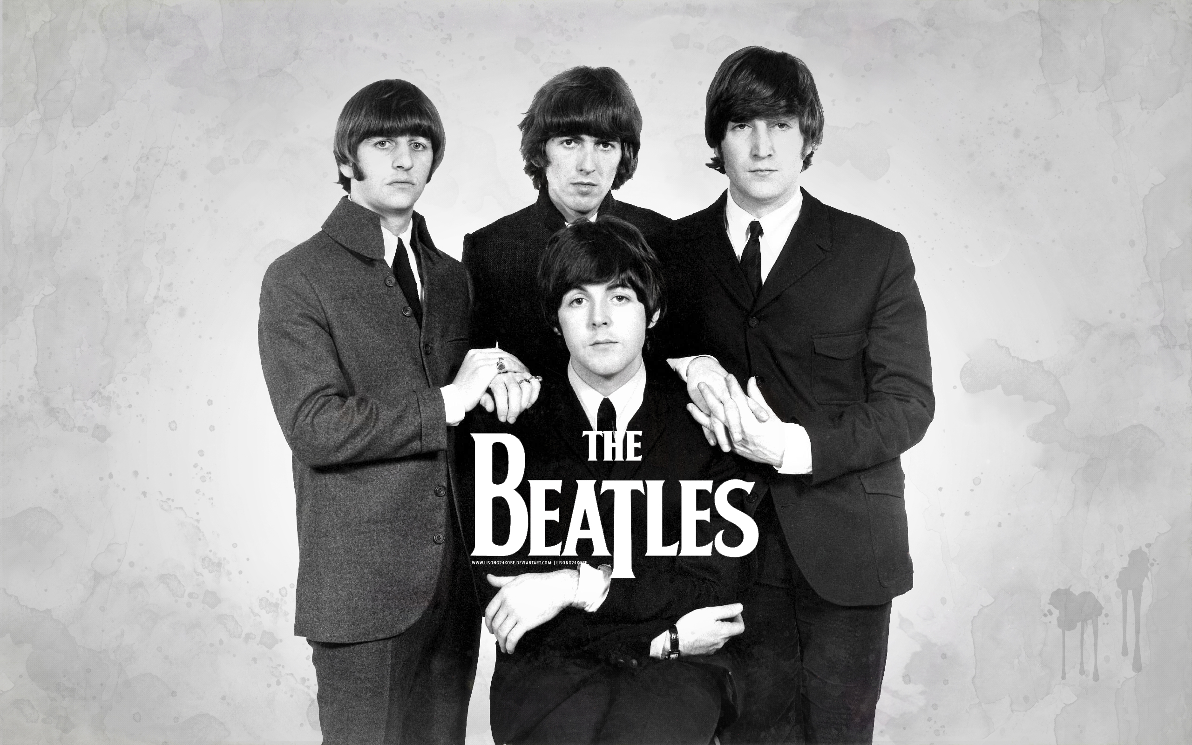

Slide 2
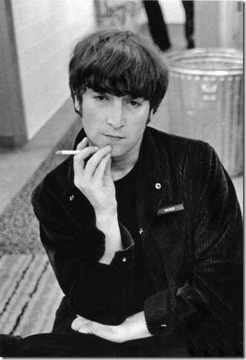
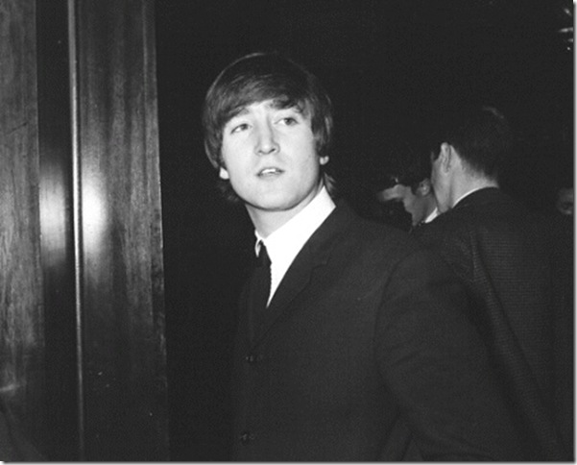
John Lennon,vocalist, guitarist

Slide 3
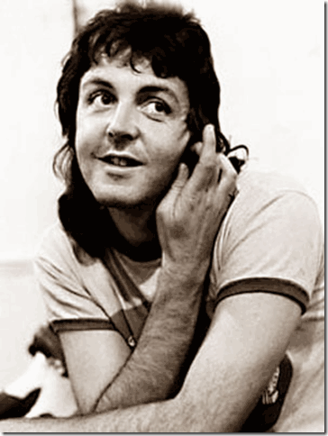
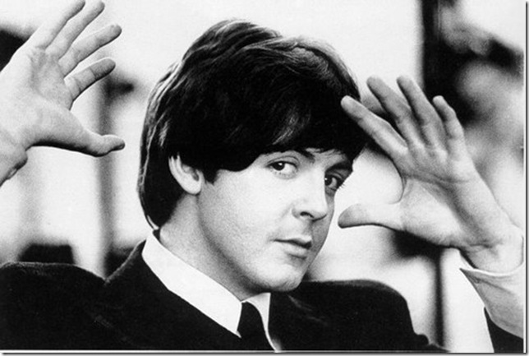
Paul McCartney (vocal and guitars)

Slide 4
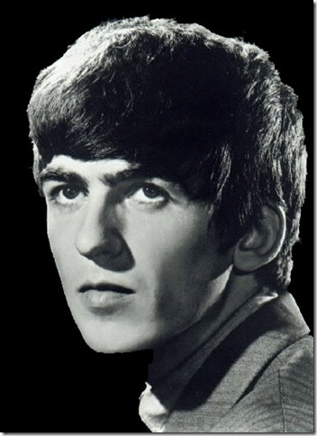
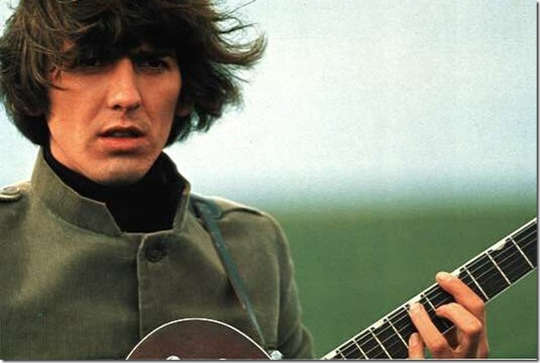
George Harrison (guitar)

Slide 5
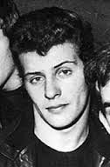
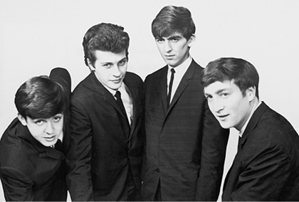
Pete Best (drums)

Slide 6
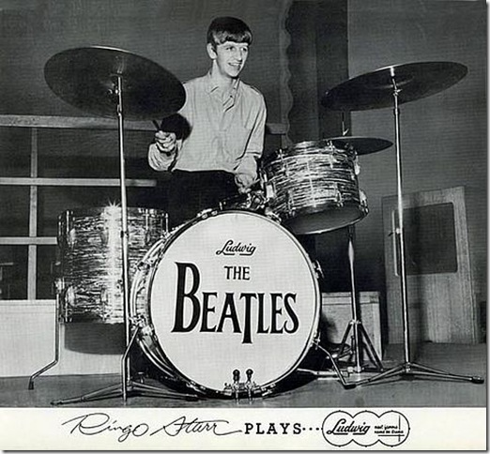
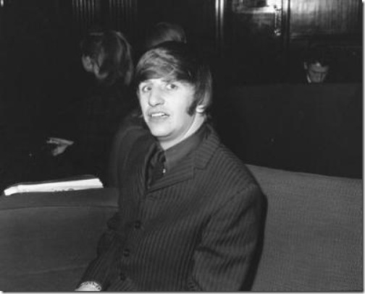
Ringo Starr

Slide 7
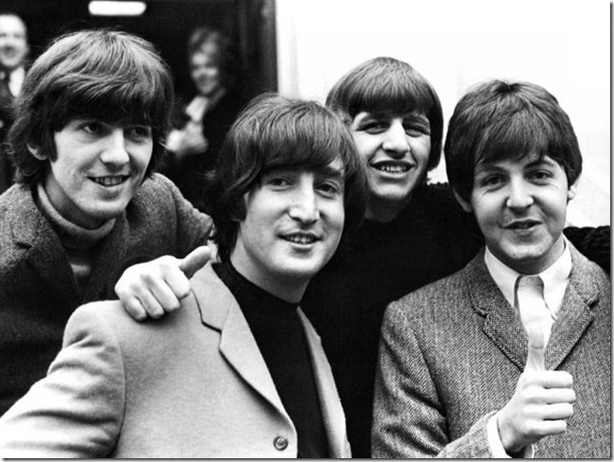
The name of the band:
“Quarrymen”
“Johnny and
the Moondogs”
“Silver Beetles”,
“The Beatles”

Slide 8
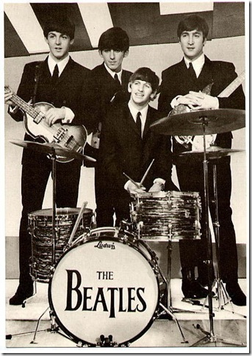

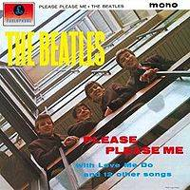
The first single:
“Please, Please Me”
1963

Slide 9
The second single – “From Me To You”
“She Loves You”
“I want to hold your hand”
"Yellow Submarine"
"Something"
“Let It Be"
“Yesterday"
“Come Together”
“Twist And Shout”

Slide 10
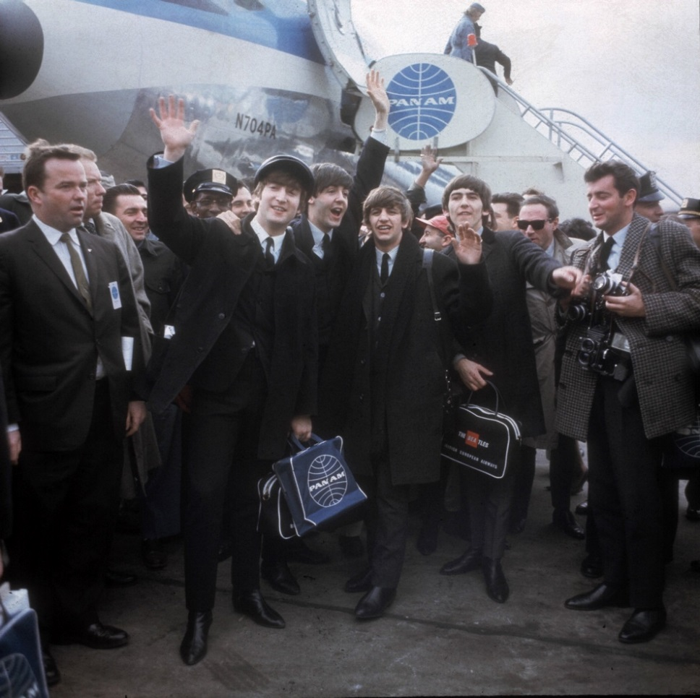
The Beatles are welcomed on the Kennedy Airport
the 7th of February,
1963

Slide 11
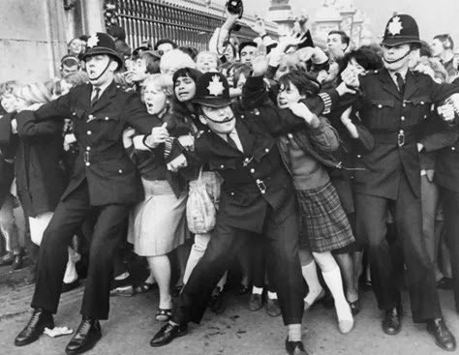
Heathrow
Airport

